Slide 1
IN THE NAME OF GOD

Slide 2
The Pain of Childbirth and Its Effect on the Mother and the Fetus

Slide 3
The gate control theory of pain described more than 40 years ago by Melzack and Wall has revolutionized

Slide 4
Gate control theory of pain

Slide 5
EXISTENCE AND SEVERITY

Slide 6
A comparison of pain scores obtained through the McGill Pain Questionnaire

Slide 7
Punishing
Wretched

Slide 8
There is the modest difference in pain scores between nulliparous women with and without prepared childbirth training

Slide 9
popularized sychoprophylaxis as a method of birth preparation this method now forms the basis for prepared childbirth training in the developed world

Slide 10
A number of individuals and scientificthought leaders still consider labor pain to be minor and unimportant.

Slide 11
ANATOMIC BASIS OF LABOR PAIN

Slide 12
First Stage of Labor

Slide 13
Uterocervical afferents activated during the first stage of labor
A
Pain
B
Pain or
analgesia
C

Slide 14
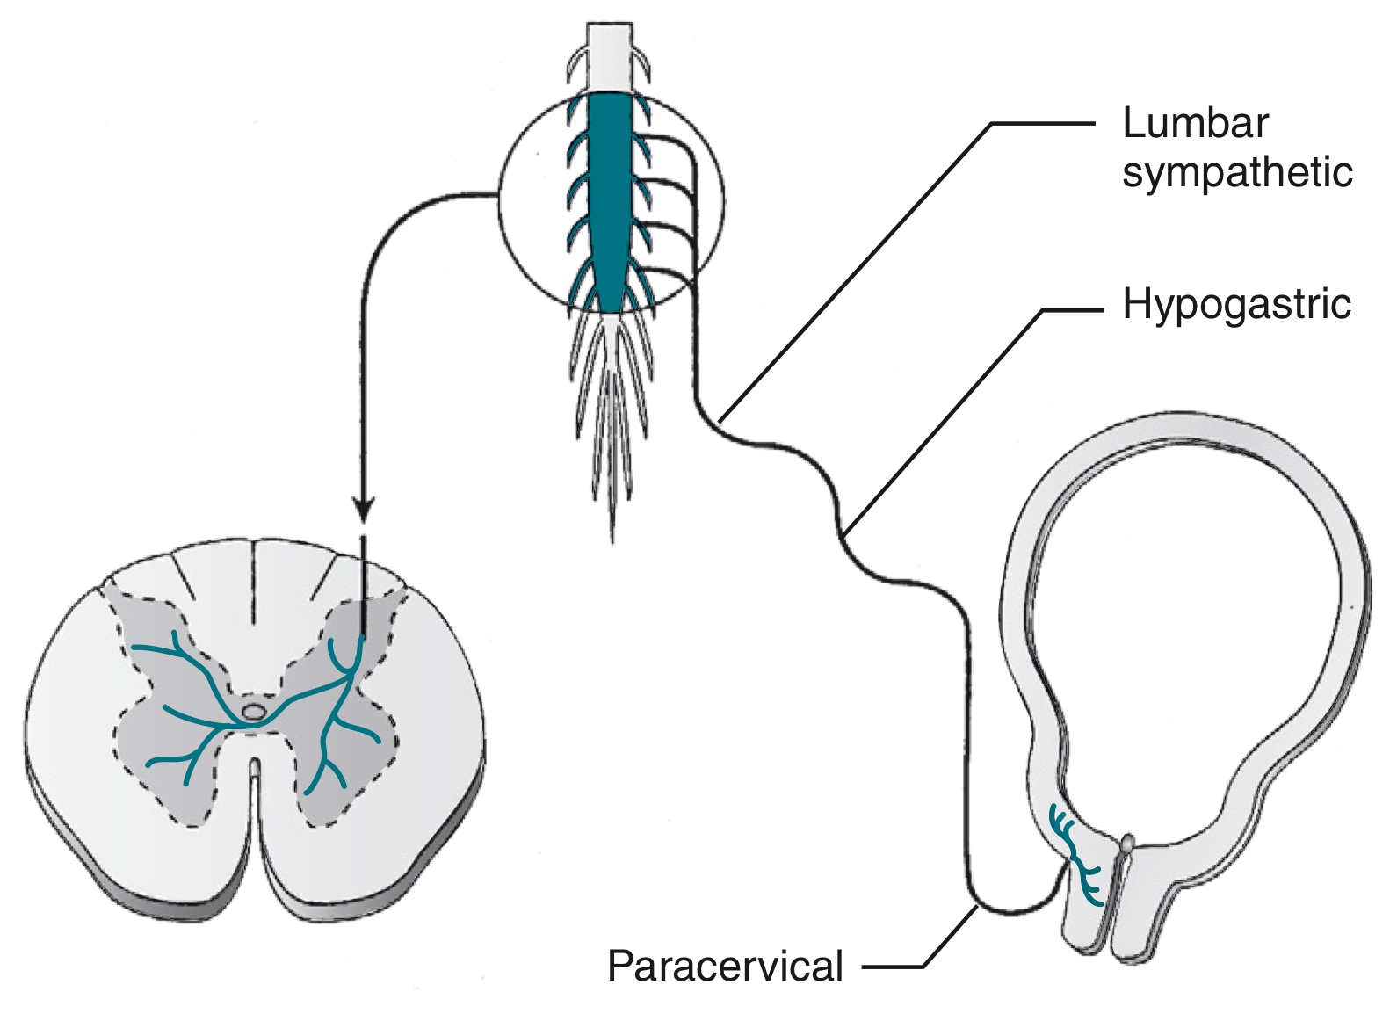
Pathways of the first stage of labor

Slide 15
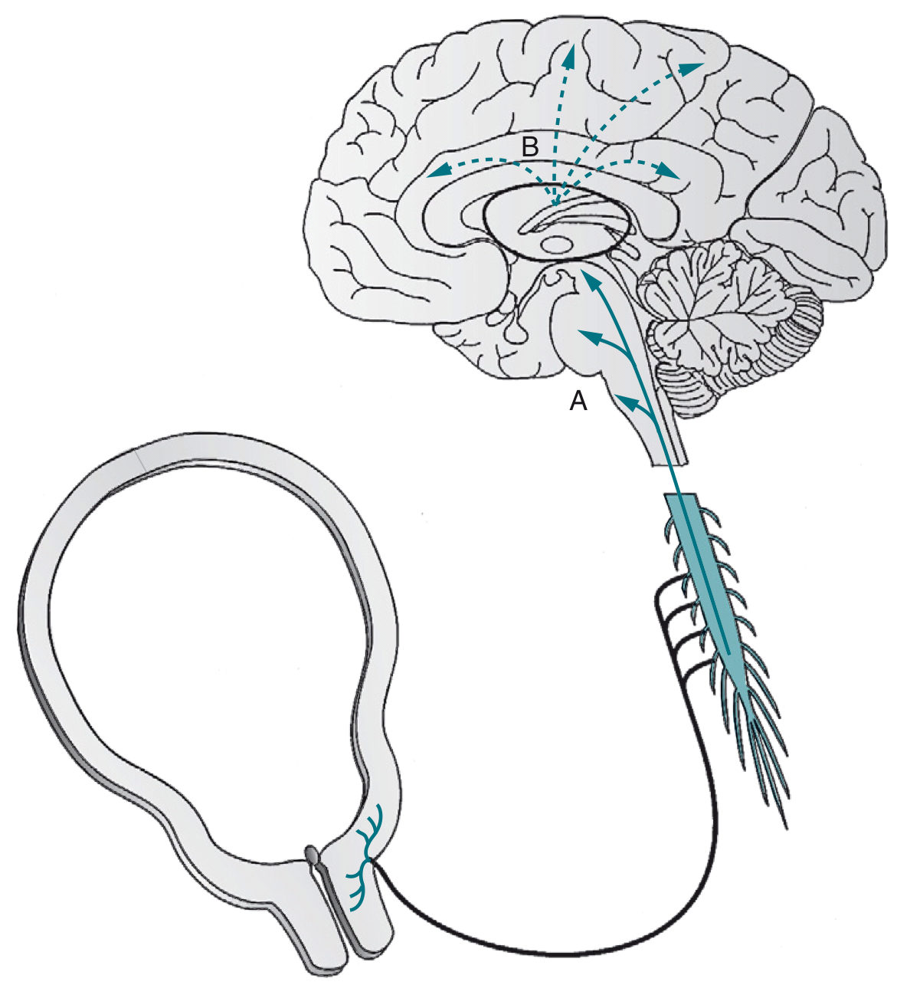
Supraspinal pain pathways activated by the pain of the first stage of labor

Slide 16
The pain of this stage blocked by :
Paracervical block
Paravertebral sympathetic Nerve block
Epidural analgesia [T10 to L1 dermatome]

Slide 17
+
Intrathecal injection of a local anesthetic and/or opioid

Slide 18
Second Stage of Labor

Slide 19
The same afferents activated during the first stage + Afferents that innervate the cervix vaginal surface vagina and perineum

Slide 20
Through the pudendal nerve at S2 to S4 and are somatic in nature
The pain of this stage blocked by :

Slide 22
INHIBITORY RECEPTORS

Slide 23
k-Opioid
receptor agonists act primarily at visceral afferent terminals in the periphery and in the supraspinal CNS to provide analgesia during the first stage of labor

Slide 24
µ-opioid
receptor agonists act in the spinal cord and the supraspinal central nervous system

Slide 25
INHIBITORY RECEPTORS

Slide 26
Pain transmission in the spinal cord

Slide 27
EFFECT ON THE MOTHER

Slide 28
Obstetric Course

Slide 29
Aspects of pain that may affect the course of labor

Slide 30
The net effect of afferent terminal–released substances inhibits rather than accelerates labor

Slide 31
Cardiac and Respiratory Effects

Slide 33
The increase in blood pressure was transient but plasma norepinephrine concentrations remained elevated for several minutes

Slide 34
EFFECT ON THE FETUS

Slide 35
Maternal labor pain can affect a number of systems that determine uteroplacental perfusion as follows:

Slide 36
Uterine contraction frequency and intensity, by the effect of pain on the release of oxytocin and epinephrine

Slide 37
Uterine artery vasoconstriction by the effect of pain on the release of norepinephrine and epinephrine

Slide 38
Maternal oxyhemoglobin desaturation

Slide 39
Which method do YOU CHOOSE ?

Slide 40
Please give me the BEST

Slide 41
THANK YOU FOR YOUR ATTENTION

